Slide 1
Fractyl
Operational Business AI

Slide 2
Fractyl can run parts or all of your e2e digital marketing & ecommerce verticals

Slide 3
PROBLEM:
Difficult and costly to run digital marketing & ecommerce at present
Have a stressed out dude over here sweating bullets
Just a few of the multiple things to worry about:
Digital ad buying
Conversion funnel optimization
Customer relationship management (CRM)
Social media management
Data analysis and management
…and many more

Slide 4
What if you could
“set it and forget it”
That’s exactly what Fractyl
allows you to do.
What if you could “set it and forget it?” That’s exactly what Fractyl allows you to do.

Slide 5
Fractyl Transforming Business AI
Almost out of Stealth
7+ years in development
5 years of selective specialist model training

Slide 6
Fractyl’s e2e AI Platform
Fractyl can help you where you need it with an automated solution
Paid digital media buying
Conversion optimization
Email and direct customer outreach
Social chatbot / SMS
Customer Segmentation
Data analysis
Product Assortment
Product Pricing
Competitive analysis
Earned Media and direct messaging on Social platforms
Content selection/ generation
LTV growth after user acquisition
Better return on media buying platforms
Email and direct outreach - Fractyl can run personalized email campaigns at scale
Social Chatbot / SMS Fractyl can respond as the athlete, brand or ecommerce company knowing much more about the consumer and personalizing what they get in the tone of voice of athlete or brand

Slide 7
How Automated is Marketing and Ecommerce?
Lane | Partially automated | Fully Automated
Paid Digital marketing
Earned Digital Marketing
Ecommerce
CRM
Fractyl
Fractyl
Fractyl
Fractyl

Slide 8
Fractyl Already Has Real World Results
Live with clients for over 3 years | >$1m of ARR | Operational in 5 business verticals
5 years of training | 5 Provisional patents ready to file | >35+ customers served
Notes:
Metric Name
Metric Category
Methodology
Formula
Breakouts
ROAS
Sales
The Return on Ad Spend (gross sales generated per $1 spent) for a property
Sales/Investment
Brand Avidity, Fan avidity, Specific team combinations, Specific channel combinations
POAS
Sales
The Return on Ad Spend (gross profit generated per $1 spent) for a property
Profit/Investment
Brand Avidity, Fan avidity, Specific team combinations, Specific channel combinations

Slide 9
Fractyl has the ability to cause a paradigm shift in ecommerce and marketing
ENGAGEMENT
OPT IN
CLICK THROUGH RATE
46%
Avg engagement rate / Social
38%
Avg opt in rate / Chatbot
32%
Avg CTR
vs
vs
vs
1.8%
Avg IG engagement rate
4.0%
SMS (closest to Chatbot)
0.5%
Avg CTR

Slide 10
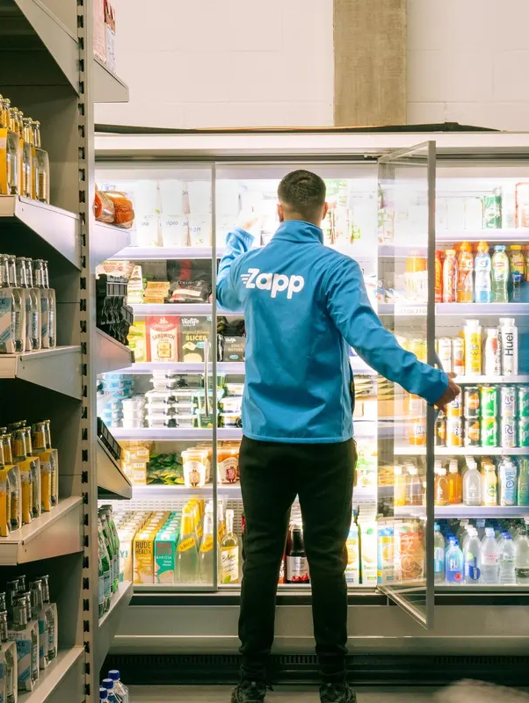
e2e eCommerce
& Marketing
Case Study
5x revenue
Growth
Paid Media / Programmatic
Segmentation custom audiences
Product selection
©2023 Fractyl Inc. Confidential & Proprietary

Slide 11
Exponential eComm Growth
Case Study
AI driving 3x Growth $3m-$9m ecommerce growth
Assortment/ pricing
Social Bot
Paid/ Programmatic
©2023 Fractyl Inc. Confidential & Proprietary

Slide 12
Exponential eComm Growth
Case Study
AI driving 3x Growth for Rodeo Drive based brand
Paid Programmatic
©2023 Fractyl Inc. Confidential & Proprietary

Slide 13
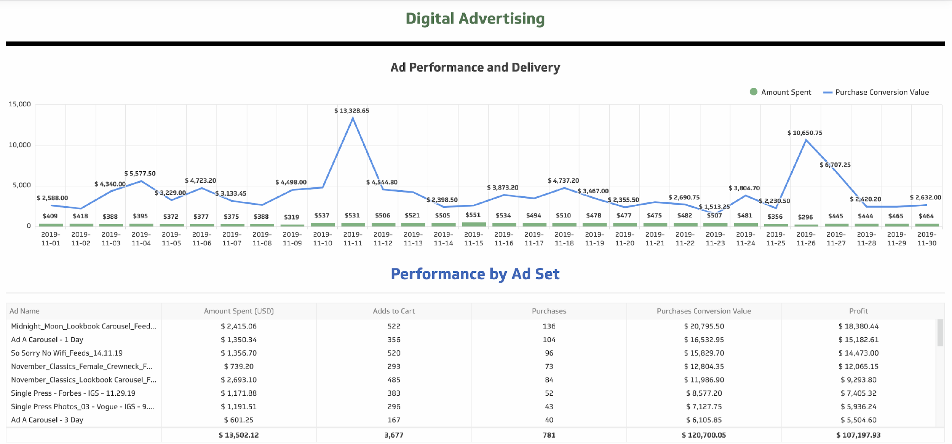
Fractyl creates ads targets and adjusts ads

Slide 14
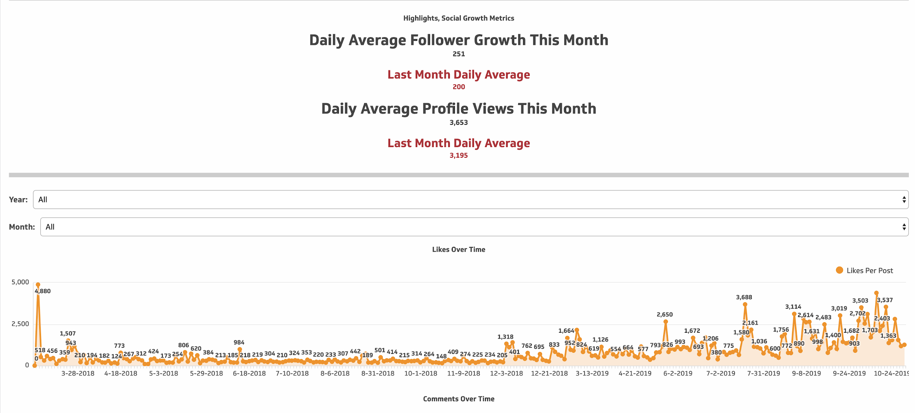
Fractyl Social bot performance
Fractyl starts
Notes:
Metric Name
Metric Category
Methodology
Formula
Breakouts
ROAS
Sales
The Return on Ad Spend (gross sales generated per $1 spent) for a property
Sales/Investment
Brand Avidity, Fan avidity, Specific team combinations, Specific channel combinations
POAS
Sales
The Return on Ad Spend (gross profit generated per $1 spent) for a property
Profit/Investment
Brand Avidity, Fan avidity, Specific team combinations, Specific channel combinations

Slide 15
Product Demo
In Person Demo

Slide 16
Sales Pipeline
Warm targets: Early Customers | Mid term: Follow on customers | Future: Strategic Deep AI tech
Existing customers ready to re engage post funding
Wasserman is an existing client of Johannes ready to use Fractyl
UTA and CAA high degree of interest
Notes:
Metric Name
Metric Category
Methodology
Formula
Breakouts
ROAS
Sales
The Return on Ad Spend (gross sales generated per $1 spent) for a property
Sales/Investment
Brand Avidity, Fan avidity, Specific team combinations, Specific channel combinations
POAS
Sales
The Return on Ad Spend (gross profit generated per $1 spent) for a property
Profit/Investment
Brand Avidity, Fan avidity, Specific team combinations, Specific channel combinations

Slide 17
Existing and interested clients can be continued during product build out
We have the unique ability to service clients at present in a boutique fashion while gaining key insights from them on how to build the most powerful front end for the product
It’s not building and hoping the end product fits the market. We’re building the product with LIVE CLIENTS IN THE MARKET.

Slide 18
Sales Forecast
 | September | October | November | December | Jan 2024 | Feb 2024
Rev | $100K | $
Clients
Lanes | E2e & ecommerce | E2e & ecommerce Social Bot | E2e & ecommerce Social Bot | E2e & ecommerce Social Bot Programmatic
Pricing model | SaaS + Performance

Slide 19
The Fractyl Moat = Deep Tech IP
Fractyl is a neuromorphic neural network which is designed to do computational analysis and decision making for things like ecommerce and marketing.
Highly accurate
Requires a fraction of the processing power and cost used by AI platforms like LLMs (It can run on a laptop. Yes, really.)
Been in existence for 7+ years, in training for 5 years, giving it a multi-year head start on any competitors

Slide 20
Management Team
Corey Simmonds
Johannes Waldstein
Dieter Neujahr
Geoff Bough
Quinton Simmonds
Founder Chief Scientist
Co-Founder CEO
CFO/COO
Advisor (Strategy)
Planned CRO/ CSO
Advisor (Technology)
ALAN AI

Slide 21
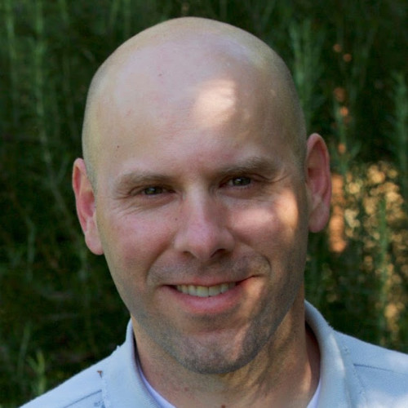
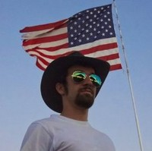
More Team
Planned Additions with next raise
Selected Background:
Corey Simmonds
The dedication and time spent over 7.5 years to invent a new type of neuromorphic network is hard to imagine. The number of seemingly impossible technical challenges that have been solved is astounding. There are 5 provisional patents ready to be filed.
Geoff Bough
Iis Chief Growth Officer at https://trillercorp.com/ and is currently selling www.Amplify.ai and working to reposition Triller as an AI Company. He brings a wealth of AI marketing and sales experience.
Mark Chavira
Markus Ziegler
Advisor CTO
Advisor Chief Data Officer
ETH Zürich

Slide 22
Financing
Family & Friends $750k | Seed $2-5m | Series A $25m+
Consumer facing product build out | Build out ecomm + programmatic AI Cloud model and API | Build data center + ecomm + programmatic AI Cloud model and API
>$1m ARR | $2m ARR | $5m ARR
Team of 5 | Team of 10 | Team of 20+

Slide 23
Thank You!
Johannes Waldstein, Co Founder & CEO | 415 988 2755

Slide 24
Appendix

Slide 25
What Fractyl Does
Capability | Description
Curated & Augmented Generative AI Platform | Small Model, expert system, to automate business marketing end to end (Fractylization/ Neuromorphic computational system/ self learning AI
Fractylization/ Neuromorphic Neural Network | Custom built neuromorphic self learning AI that has trained for 5 years on business data
Decision Matrix/ NLP | Custom built NLP, Predicts consumer engagement, chatbots, sentiment analytics, translation, text summarization
Expert System | Ingests learnings from internal business operations and operators for maximum customization and relevance.
Image selection/ Generation | Makes decisions based on precedence and multi-platform analytics
Text Generation | Determines and develops a set of linguistic conventions that determine brand persona
Excel and automated spreadsheet and financial analysis output | The program works alongside human talent to conversationally incorporate user input and internal business context
Financial Computational AI | Can run numerical computations and is not constrained to language processing
Notes:
Metric Name
Metric Category
Methodology
Formula
Breakouts
ROAS
Sales
The Return on Ad Spend (gross sales generated per $1 spent) for a property
Sales/Investment
Brand Avidity, Fan avidity, Specific team combinations, Specific channel combinations
POAS
Sales
The Return on Ad Spend (gross profit generated per $1 spent) for a property
Profit/Investment
Brand Avidity, Fan avidity, Specific team combinations, Specific channel combinations

Slide 26
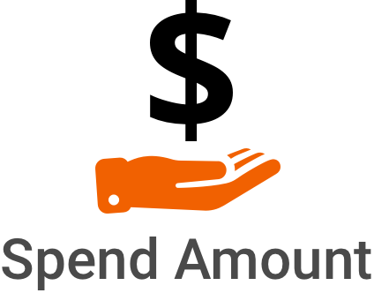
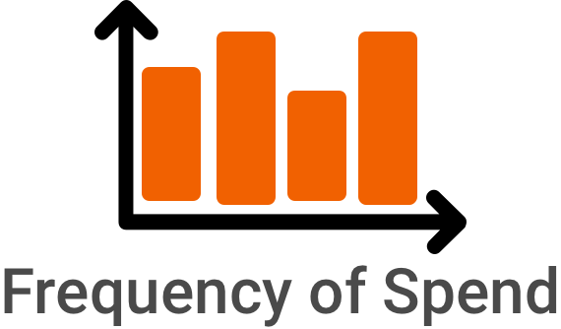
Fractyl e2e platform
db
Business Outcome
Audience Monetization
Revenue growth

Slide 27
Fractyl a day in the life e2e marketing
Planning | Content | Social | Paid Media | d2c | Ecommerce | LTV (Lifetime customer Value)
GTM Strategy Segmentation Assortment Pricing Testing above | Content engine Content selection Testing content | Conversational AI Social bot | Programmatic | Email SMS | Site visit to product Add to basket Basket to purchase Customer service Concierge | Repurchase Subscription
Draft needs work

Slide 28
Fractyl Neuromorphic Neural Network
Fractyl has built a Neuromorphic Neural Network from scratch which is a new approach to solving generative AI.
Large Language Models (LLMs) are generalists and not designed to do computational analysis and decision making for things like ecommerce and marketing.

Slide 29
Finance
 | 2021 (Stealth) | 2022 (Stealth) | 2023 ½ (Stealth) | 2024 | 2025 | 2026
Rev | $525K | $670k
Cost
Profit
Team

